Slide 1

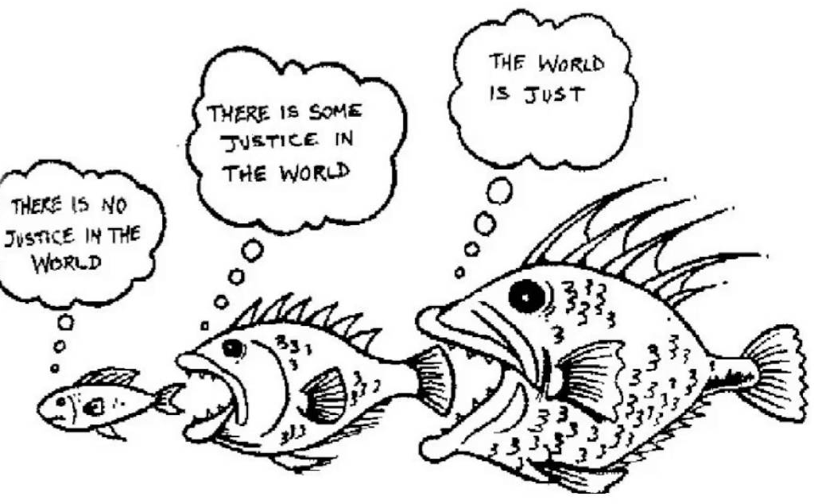
The Influence of Brand Relationships on Sense of Justice in the Context of Service Recovery
Marc Fetscherin, Alex Blandina and Cid Goncalves

Slide 2

Introduction
Service recovery are the actions accomplished by a company in response to a product or service failure, in hopes of converting a dissatisfied customer into a satisfied one (Tax et al., 1998)

Slide 3

Introduction
Service failures negatively impact the relationships brands work to build
  Service recovery strategies help to reduce this impact (Tax et al., 1998)
Service recovery strategies provide ambiguous effects
  Positive effect
    Customers with closer relationships with the brand are more likely to forgive failures (Mattila, 2001)
  Negative Effect
    Love-becomes-hate (Grégoire et al., 2009)
Notes:
an action by a company in response to a product or service failure in hopes of converting a dissatisfied customer into a satisfied one (Tax et al., 1998)

Slide 4

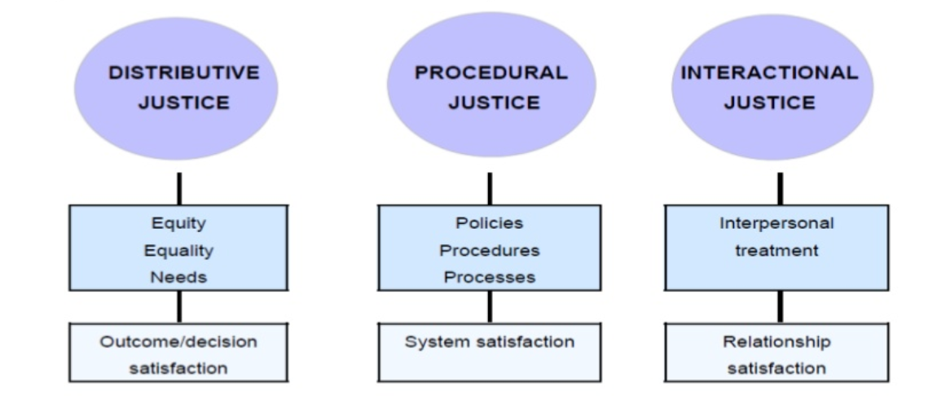
Introduction
Service recovery research has turned to justice theory as the principal theoretical framework

Slide 5
Objective & Research Model
Notes:
Developed and tested the interaction between:
Brand Relationship Quality (BRQ) and three forms of justice (distributive, procedural, interaction)
On satisfaction of complaint handling and three types of customer behaviors (complaining, retaliation, purchase intention).

Slide 6

Data was collected using an online survey sent out to a panel of 11,844 car owners from 20 different states in Brazil
  Automobiles are a durable good that often utilizes service recovery efforts
  Brazil is the 9th largest vehicle market in the world, with about 2.24 million vehicles sold in 2017 and the 10th in production
After a collection period of 30 days, we obtained 368 valid answers

Slide 7
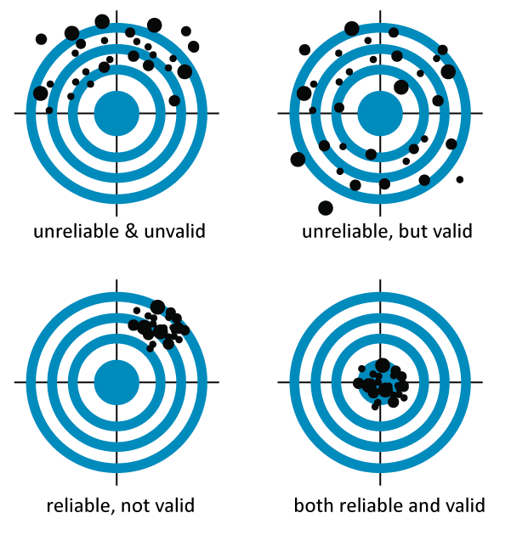
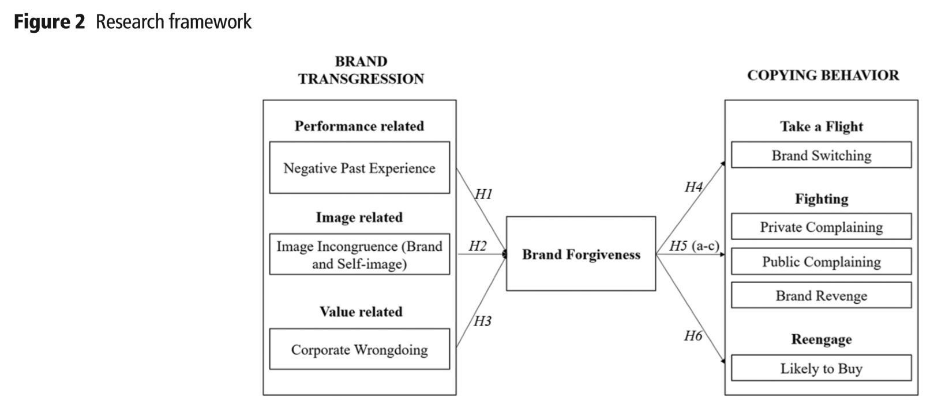
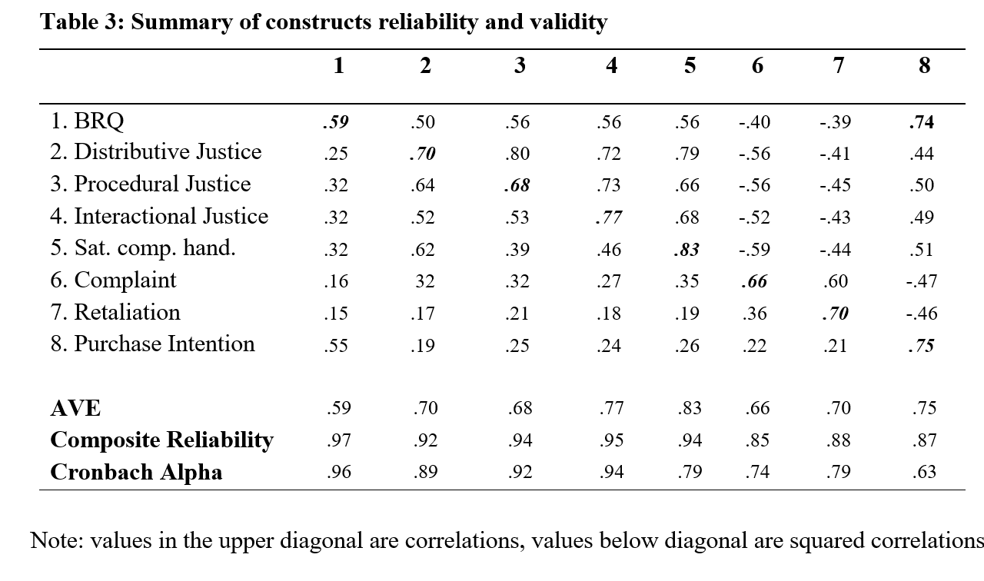
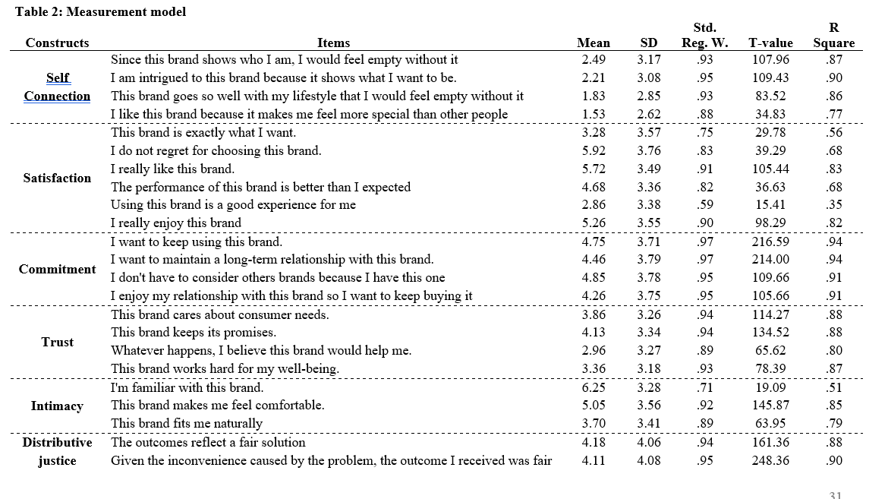
Validity and Reliability
  Sample adequacy with KMO > 0.5
  Reliability, Cronbach’s a values > 0.70
  CFA with no item had signiﬁcant cross-loadings
  Multicollinearity (VIF) unproblematic
  Convergent validity AVE > 0.50 and CR > 0.60
  Discriminant validity AVE > SIC
  SEM and model fit indexes

Slide 8
Results

Slide 9
Results – Alternative Model
Results

Slide 10
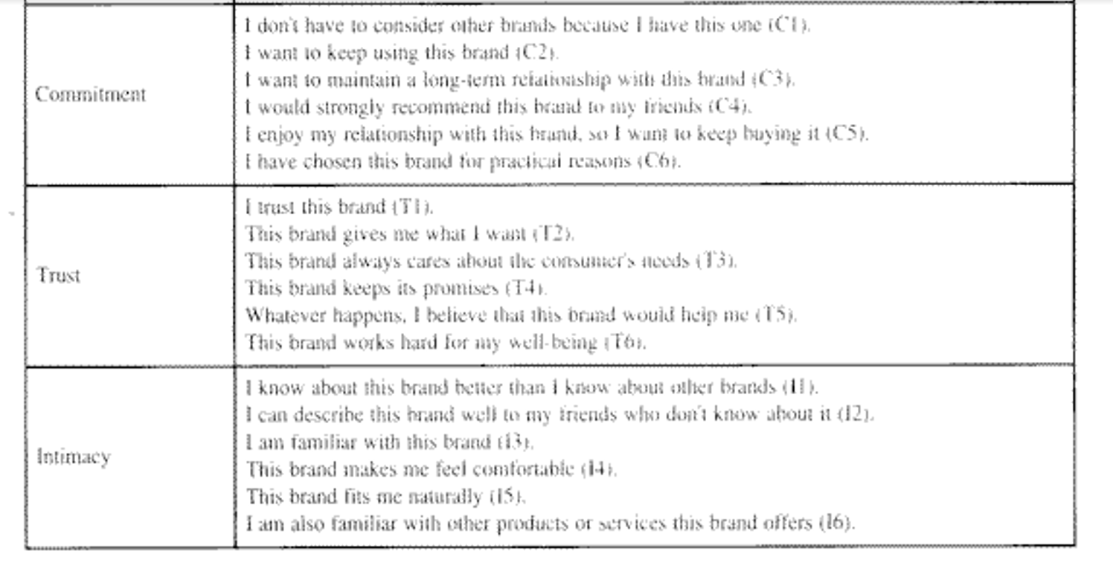

Slide 11


Discussion
Stronger BRQ leads to more perceived justice (distributive, procedural and interactional), which in turn led to higher satisfaction and positive consumer responses
BRQ positively influenced the customers’ negative judgment established in a brand crisis or service failure situation through their perceptions of justice
  BRQ was a significant antecedent of perceived justice
Distributive justice presented the highest impact on satisfaction with consumers’ complaints
  Could be due to the examined category
    Automobile industry requires high involvement and focuses consumers on an outcome

Slide 12





Managerial implications
Findings identify relevant paths to successful service recovery
The importance quality of the relationship with the brand and consumer as Justice Antecedent
Provide equitable outcomes (distributive justice) in relation to the service failure
  Promptness (procedural justice) and empathy and warmth (interactional justice) within the interaction help too
  Reduces Complaint, Retaliation and increases Purchase Intention

Slide 13
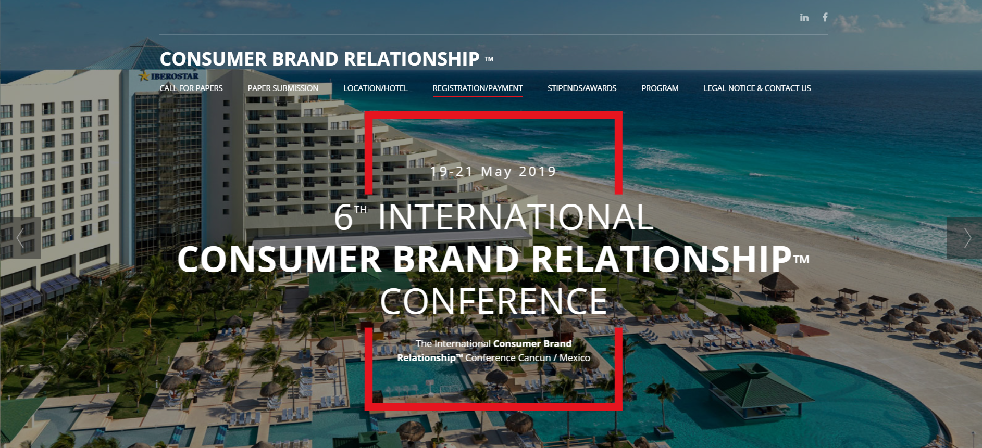
Thank you!

